Slide 1


Project Domain: Communications (Including Microwave and RF)
 | VALLURUPALLI NAGESWARA RAO VIGNANA JYOTHI INSTITUTE OF ENGINEERING AND TECHNOLOGY An Autonomous, ISO 9001:2015 & QS I-Gauge Diamond Rated Institute, Accredited by NAAC with ‘A++’ Grade NBA Accreditation for B.Tech. CE,EEE,ME,ECE,CSE,EIE,IT,AME, M.Tech. STRE, PE, AMS, SWE Programmes Approved by AICTE, New Delhi, Affiliated to JNTUH, NIRF (2022) 113 Rank in Engineering Category College with Potential for Excellence by UGC,JNTUH-Recognized Research Centres:CE,EEE,ME,ECE,CSEVignanaJyothi Nagar, Pragathi Nagar, Nizampet (S.O.), Hyderabad – 500 090, TS, India. Telephone No: 040-2304 2758/59/60, Fax: 040-23042761 E-mail: postbox@vnrvjiet.ac.in, Website: www.vnrvjiet.ac.in
Optical Communication System for Multi-Format Data Transmission Using Laser Technology
Project Batch No: 19

Slide 2
INTRODUCTION
Our project introduces a novel Optical Communication System designed to transmit multi-format data using laser module , Arduino, and solar panel. This system transforms text data into ASCII code and then into binary form for transmission via laser, showcasing a simple yet effective method for sending text-based information.
Additionally, our system is designed to accommodate more complex formats, such as images. We achieve this by encoding images into Base64 format prior to transmission through the laser. This dual-functionality ensures that both simple and complex data can be communicated efficiently.

Slide 3
OBJECTIVE
Develop an Optical Communication System that transmits text and image data using laser technology, Arduino, and a solar panel.
Implement data conversion techniques to transmit text as binary and images via Base64 encoding through laser communication.
Utilize Arduino for signal modulation and a solar panel for receiving and converting light pulses back into data.
Integrate Python scripts for encoding and decoding, ensuring accurate data reconstruction across different formats.

Slide 4
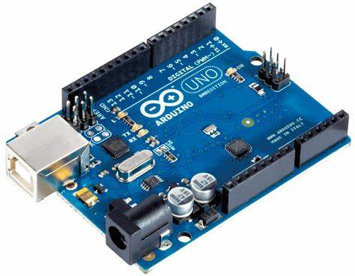
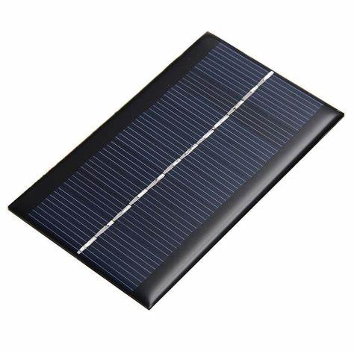
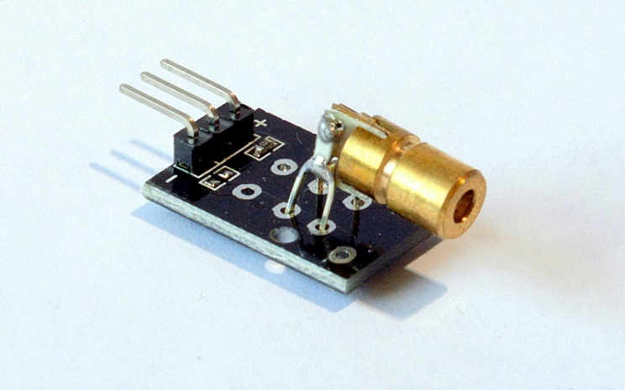
COMPONENTS
SOFTWARE
Arduino uno’s
Laser Module
Solar Panel
Arduino ide
Visual Studio Code

Slide 5
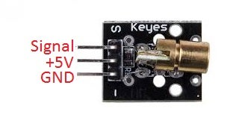
LASER MODULE HW- 493
Wavelength 650nm Red Output
Brass construction with acrylic lens
Built-in current limiting resistor
Operating Voltage 5V
Output Power 5mW
Operating Current < 40mA
Working Temperature -10°C ~ 40°C
Dimensions: 18.5mm x 15mm

Slide 6
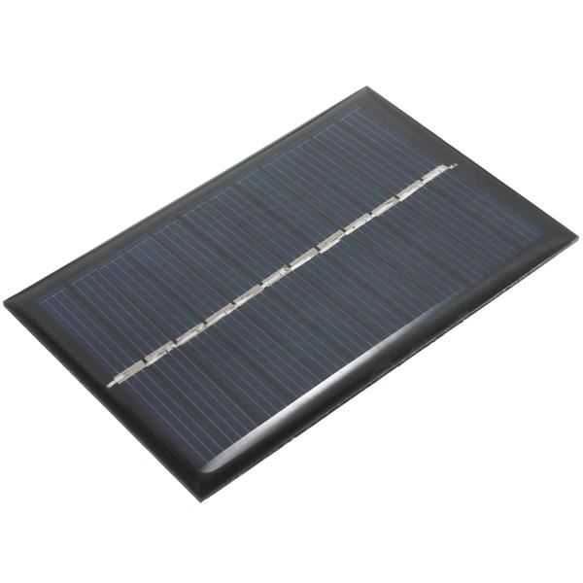
SOLAR PANEL
The max voltage is 5.5
The power is 0.65W
The max current is 0.12A
High rigidity and long life
scratch-resistant protective film.

Slide 7
Text Data Transmission
Data Conversion: Text information is converted into ASCII code, which represents each character as a numerical value. This numerical data is then transformed into binary form (0s and 1s), creating a sequence of bits.
Laser Transmission: An Arduino processes this binary data to control a laser diode, which emits light pulses corresponding to the binary sequence. These pulses transmitted detected by solar panel.
Conversion to Electrical Signals: The solar panel converts the detected light pulses into electrical signals. These signals are then processed by an attached circuit or microcontroller to reconstruct the binary sequence (0s and 1s) that was originally transmitted.
Binary Data Reconstruction: The electrical signals are interpreted to retrieve the binary data stream. This data stream is grouped into 8-bit segments, each representing an ASCII character.it the text data across a direct line-of-sight path to the receiver.

Slide 8
Image Data Transmission
Data Conversion: For image data, the image file is converted into Base64 encoding using a Python script in Visual Studio Code (VSCode). Base64 encoding transforms the binary image data into a text format, making it suitable for transmission.
Laser Transmission: The Base64 encoded string is used to modulate the laser beam. The Arduino controls the laser to emit light patterns representing the encoded image data, allowing the image to be transmitted effectively.
Conversion to Electrical Signals: The detected light pulses are converted into electrical signals. These signals are processed by an Arduino or a similar microcontroller to reconstruct the Base64 encoded string from the received light patterns.
Python Script for Decoding: On the computer, a Python script is used to decode the Base64 string and reconstruct the image file.

Slide 9
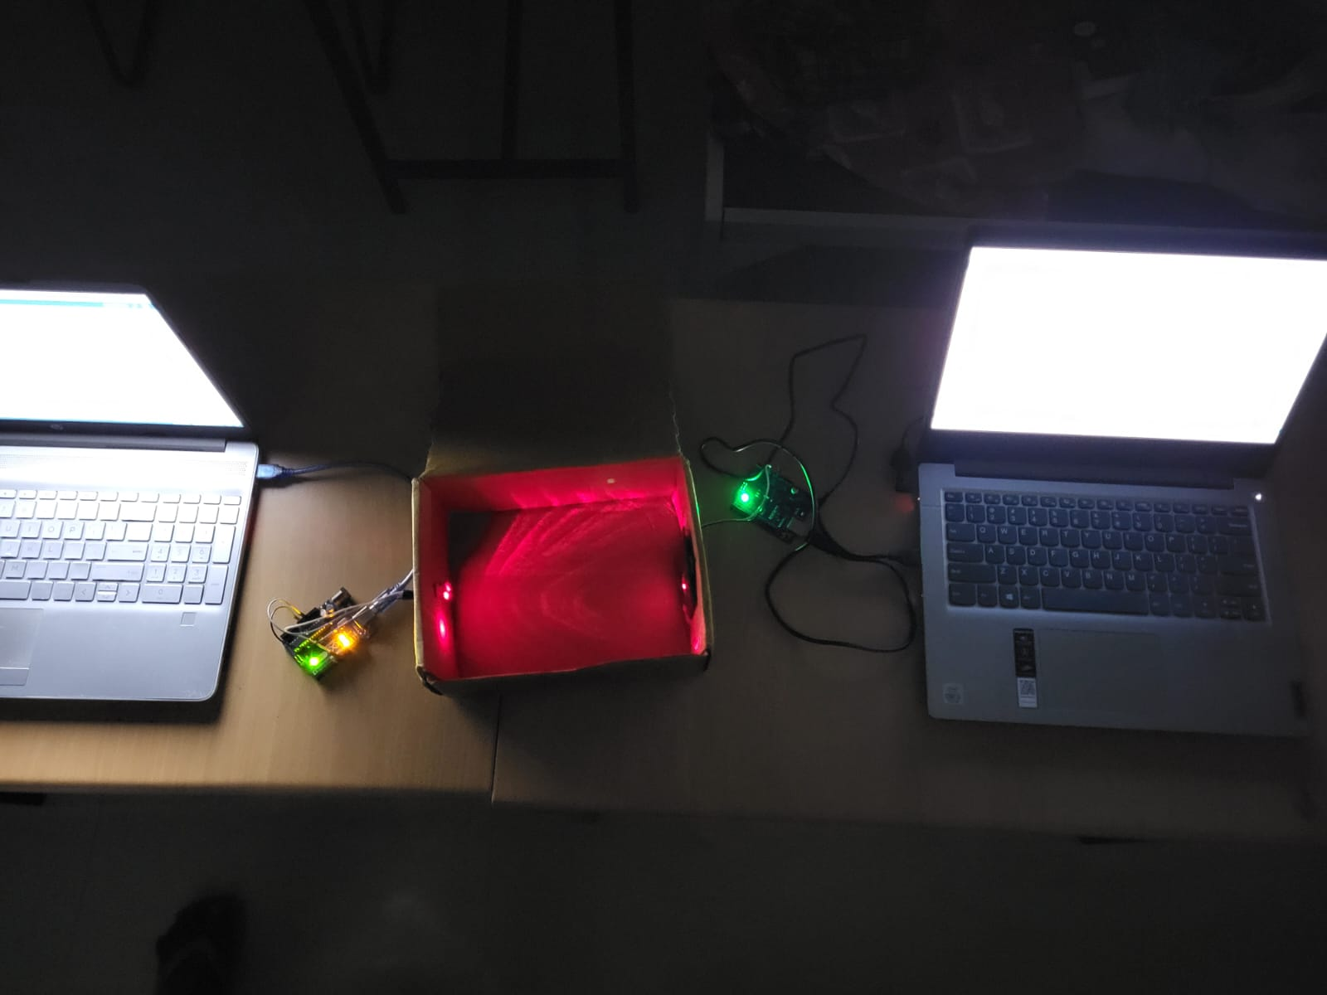
HARDWARE SETUP

Slide 10
DRAWBACK USING ARDUINO UNO
The Arduino Uno is equipped with only 32 KB of Flash memory and 2 KB of SRAM, which restricts its ability to handle large amounts of data, especially when it comes to transmitting and processing larger formats such as Base64 encoded images.
Base64 encoding, which is commonly used to represent binary data in text format, can significantly increase the size of the data. For instance, Base64 encoding typically enlarges the size of the original data by approximately 33%.
This means that handling and transmitting large Base64 encoded images or substantial amounts of data can quickly exceed the storage and memory limitations of the Arduino Uno.

Slide 11
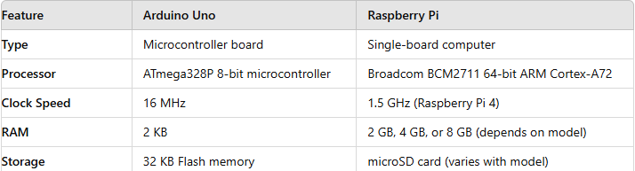
RASPBERRY PI
Raspberry Pi’s superior storage capacity and processing power make it the preferred choice for handling and transmitting larger Base64 encoded data, ensuring more efficient and reliable performance.

Slide 12
REFERENCES
https://ieeexplore.ieee.org/document/9498473
“Free Space Optical Wireless Communication using Lasers Array for Data Transmission”
https://ieeexplore.ieee.org/document/10601792
“An Approach for Secure Communication using LiFi Technology with Laser in Border Areas”
https://ieeexplore.ieee.org/abstract/document/10428674
“Li-Fi Data Transmission Using Visible Light Communication Technology”
https://ieeexplore.ieee.org/abstract/document/10307647
“Design of a LiFi System for Short-Distance Communications”

Slide 13


